Slide 1
Module 3: Security
Detection with Supervised Learning
ML for Cybersecurity
Fall 2020

Slide 2
Learning Objective

Slide 3
Learning Objectives
Learn about different types of network attacks
Learn how machine learning can be applied to cyberattack detection
Learn about the different approaches to detection, supervised and unsupervised learning

Slide 4
BOTNETS

Slide 5
Botnets
Bots: Autonomous programs performing tasks
Plenty of “benign” bots
e.g., weatherbug
Botnets: group of bots
Typically carries malicious connotation
Large numbers of infected machines
Machines “enlisted” with infection vectors like worms (last lecture)
Available for simultaneous control by a master

Slide 6
Defenses: Monitoring and Takedown

Slide 7
Early Days: IRC-Based Monitoring
Join IRC channel, monitor all communications
This approach became more difficult over time
Move towards encrypted C&C Communication
Move away from IRC-based botnets (as predicted)

Slide 8
Botnet Detection and Tracking
Network Intrusion Detection Systems (e.g., Snort)
Signature: alert tcp any any -> any any (msg:"Agobot/Phatbot Infection Successful"; flow:established; content:"221
Honetpots/Honeynets: gather information
Run unpatched version of Windows
Usually infected within 10 minutes
Capture binary
determine scanning patterns, etc.
Capture network traffic
Locate identity of command and control, other bots, etc.
“Internet Motion Sensor”

Slide 9
Using DNS Traffic to Find Controllers
Different types of queries may reveal info
Repetitive A queries may indicate bot/controller
MX queries may indicate spam bot
PTR queries may indicate a server
Usually 3 level: hostname.subdomain.TLD
Names and subdomains that just look rogue
(e.g., irc.big-bot.de)

Slide 10
DNS Monitoring
Command-and-control hijack
Advantages: accurate estimation of bot population
Disadvantages: bot is rendered useless; can’t monitor activity from command and control
Complete TCP three-way handshakes
Can distinguish distinct infections
Can distinguish infected bots from port scans, etc.

Slide 11
SPAM and MESSAGE ABUSE

Slide 12




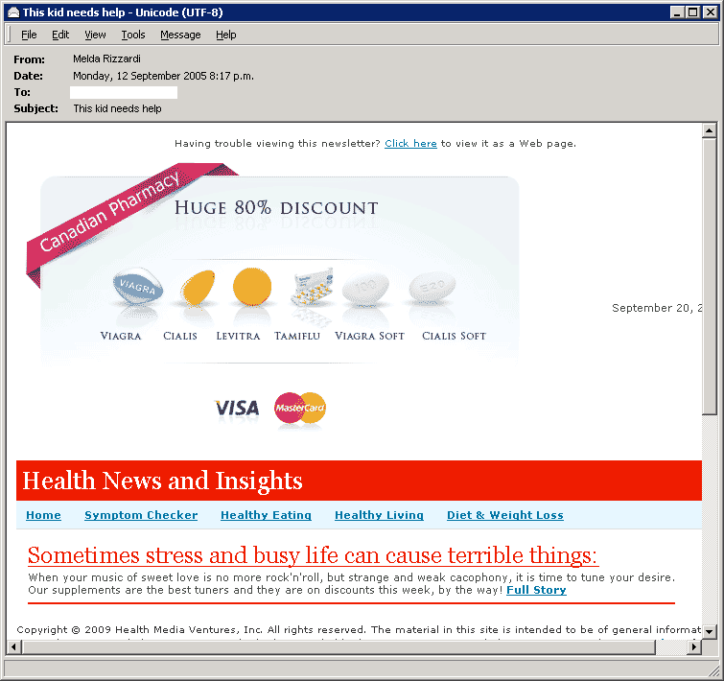



Spam-related activity
Time
Introduction
Distribute spam messages
Maintain hosting infrastructure
Acquire network resources
DNS server
Register .com domains
Botnet
Web server
Registrar
Registry
ICANN
Spam message
Spam-advertised page

Slide 13
1st challenge: How to find useful features?
Introduction
Attack agility
Sending agility
Botnets to acquire IP dynamics
750K spam emails found from hacked fridges and TVs (reported Jan 2014)
Hosting agility
Embedded URLs to direct to spam-advertised sites
Naming agility
New domains registered to evade blacklisting

Slide 14
2nd challenge: How to make decision quickly?
Introduction
Large scale of data
Email service
Thousands of email addresses in an enterprise-like network
About 150 billion emails worldwide per day (source: Internet live stats)
DNS nameservers
Billions of DNS queries at top-level nameservers per day
Registries and registrars
Hundreds of thousands of new domains registered per day

Slide 15


Feature example: geodesic distance
SNARE
Intuition:
Social structure limits the region of contacts
The geographic distance travelled by spam from bots is close to random
Legitimate sender
close
distant
Spammer
Recipient

Slide 16
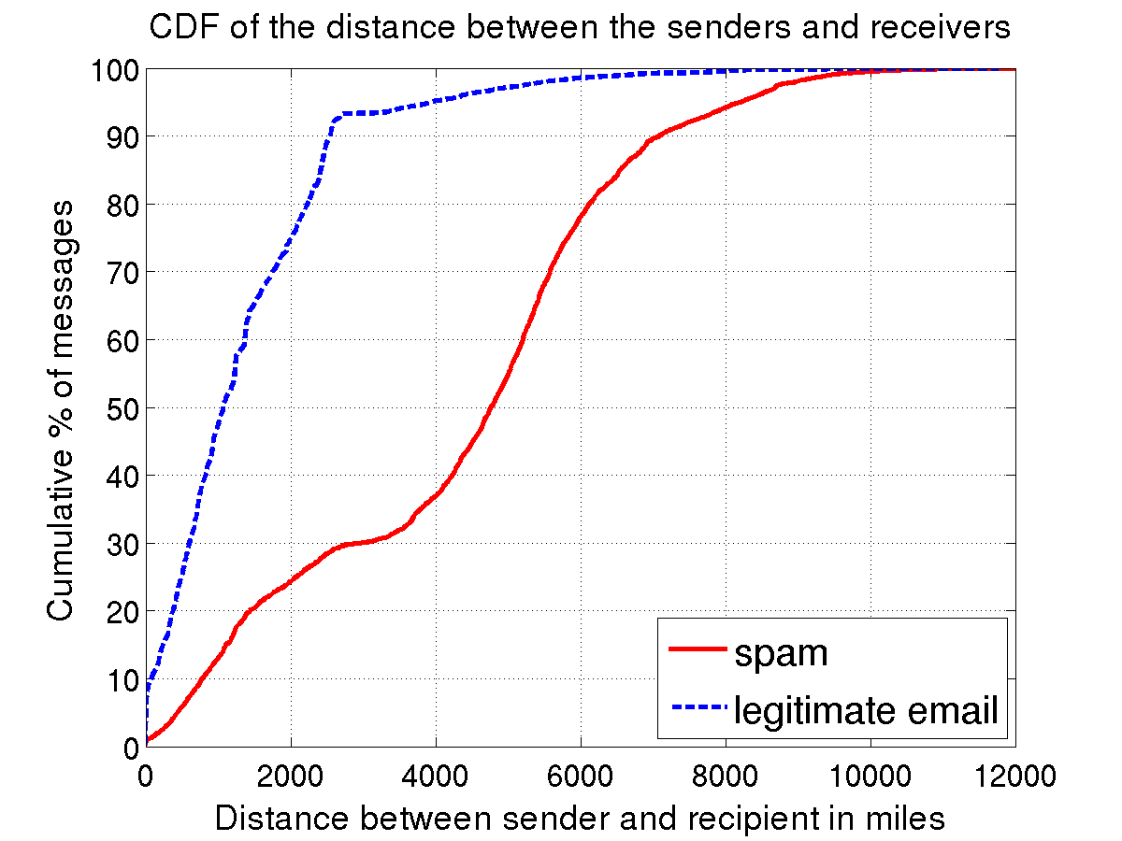
Distribution of geodesic distance
Find the physical latitude and longitude of IPs based on MaxMind’s GeoIP database
SNARE
90% of legitimate messages travel 2,500 miles or less
Observation: Spam travels further

Slide 17
Network-level features
SNARE
Single-packet
Geodesic distance
Sender IP neighborhood density
Time of day
AS of sender’s IP address
Status of email service ports
Single-header/message
Number of recipients
Message length
Aggregate
(multiple message/recipient)

Slide 18
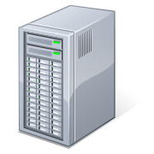

Monitoring DNS lookups
DNS behavior
TLD name server
2LD authoritative
name server
Collection process
Querying /24 subnets aggregated every day
Collection point
RDNS
RDNS
RDNS
End users
example.com 111.111.111.0 , 222.222.222.0

Slide 19
Domain registration analysis
Registration
Understanding the domain registration behavior of spammers
Characterization: How the domain is registered?
Fact: Tens of thousands of domains registered to maintain spam campaigns
Intuition: Registration behavior is different due to spammers’ economic or management concerns
Hao et al. Understanding the Domain Registration Behavior of Spammers, IMC 2013

Slide 20




Domain registration process
Registration
Registrant
Registrar (e.g., GoDaddy) brokers registrations
Registry (e.g., Verisign) manages registration database
Update
Database
Top-level nameservers

Slide 21
Registrars hosting spammer domains
The registrars ranked by the percentages of spammer domains
Registration
 | Registrar | Spam %
1 | eNom, Inc. | 27.03%
2 | Moniker Online Services, Inc. | 19.01%
3 | Tucows.com Co. | 4.47%
8 | OnlineNIC, Inc. | 2.13%
9 | Center of Ukrainian Internet Names | 2.07%
10 | Register.com, Inc. | 1.89%
Spammer
domains
All domains added to the zone
70%
20%
Finding: A handful of registrars account for the majority of spammer domains

Slide 22
Spam proportions on registrars
Registration
Are there registrars that host only spammer domains?
Finding: Spammers primarily use popular registrars

Slide 23
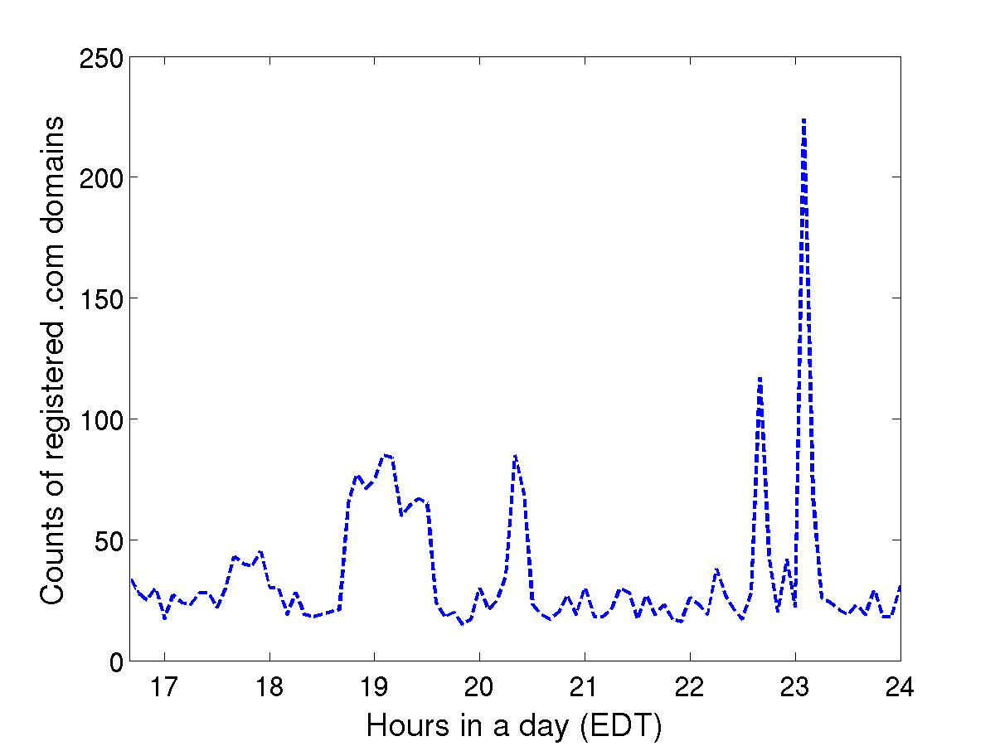
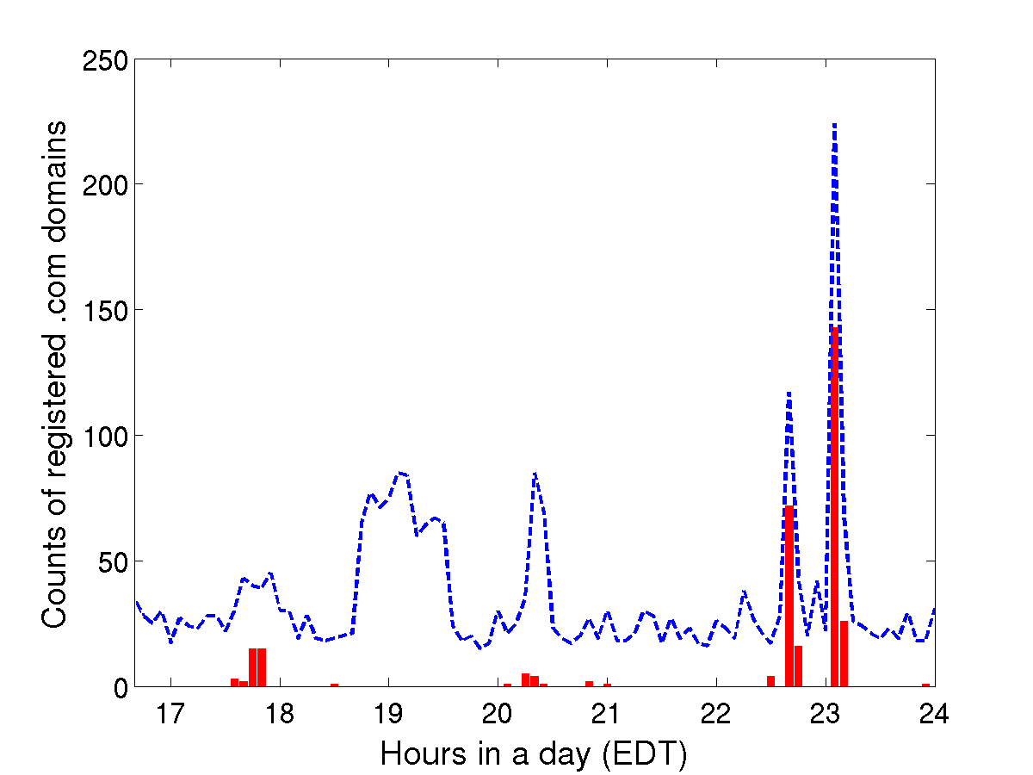
An example of bulk registration
Registration
Domains registered by eNom every 5 minutes in March 5th, 2012
New spammer domains every 5 minutes
New domains every 5 minutes

Slide 24
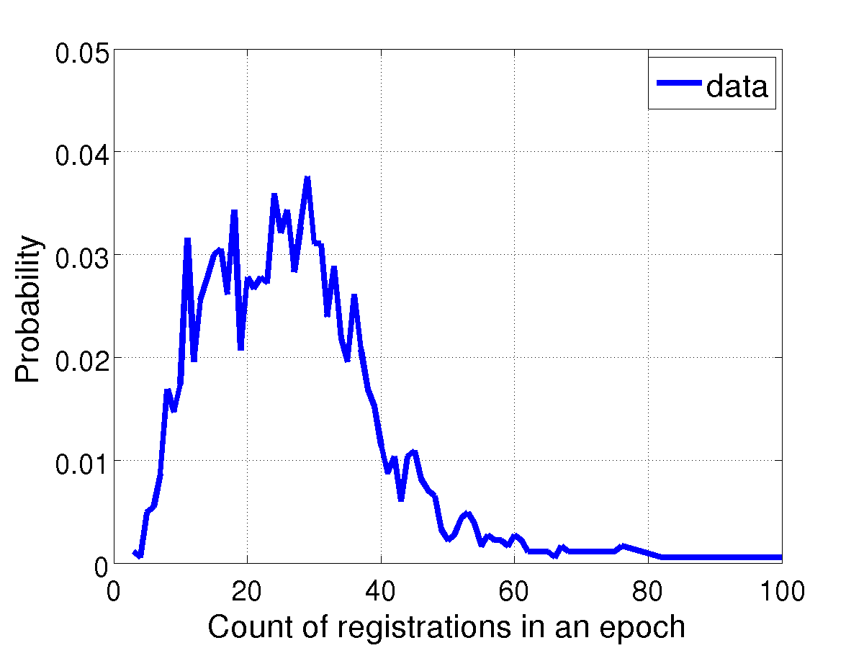
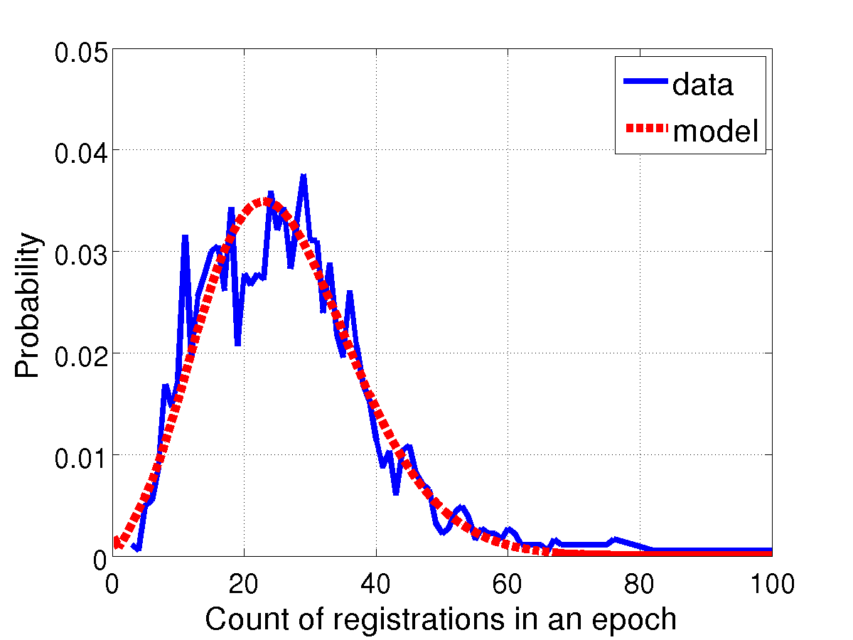
Modeling registration batch sizes
How to identify “abnormally large” registration batches?
Registration
Build hourly models to fit diurnal patterns
Compound Poisson to represent the customer purchase behaviors
Spike:
low probability
eNom, Inc., hourly window, 10AM–11AM ET

Slide 25
Supervised learning: CPM
PREDATOR
Convex polytope machine (CPM)
High accuracy
Train models fast
SVM
CPM
X
X
X
X
X
X
X
X
X
X
X
X

Slide 26
NaÏVE BAYES DEtection

Slide 27
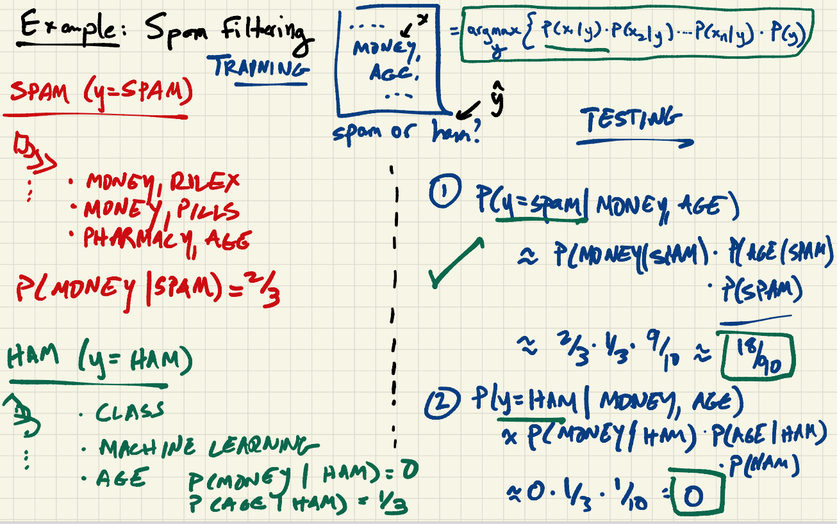

Slide 28
DEMONSTRATION: SPAM Detection

Slide 29
